Slide 1
Facial Recognition of Fútbol Players
Identifying a target player on the Fútbol pitch
Thomas Widdows
Capstone 2 Project Presentation

Slide 2
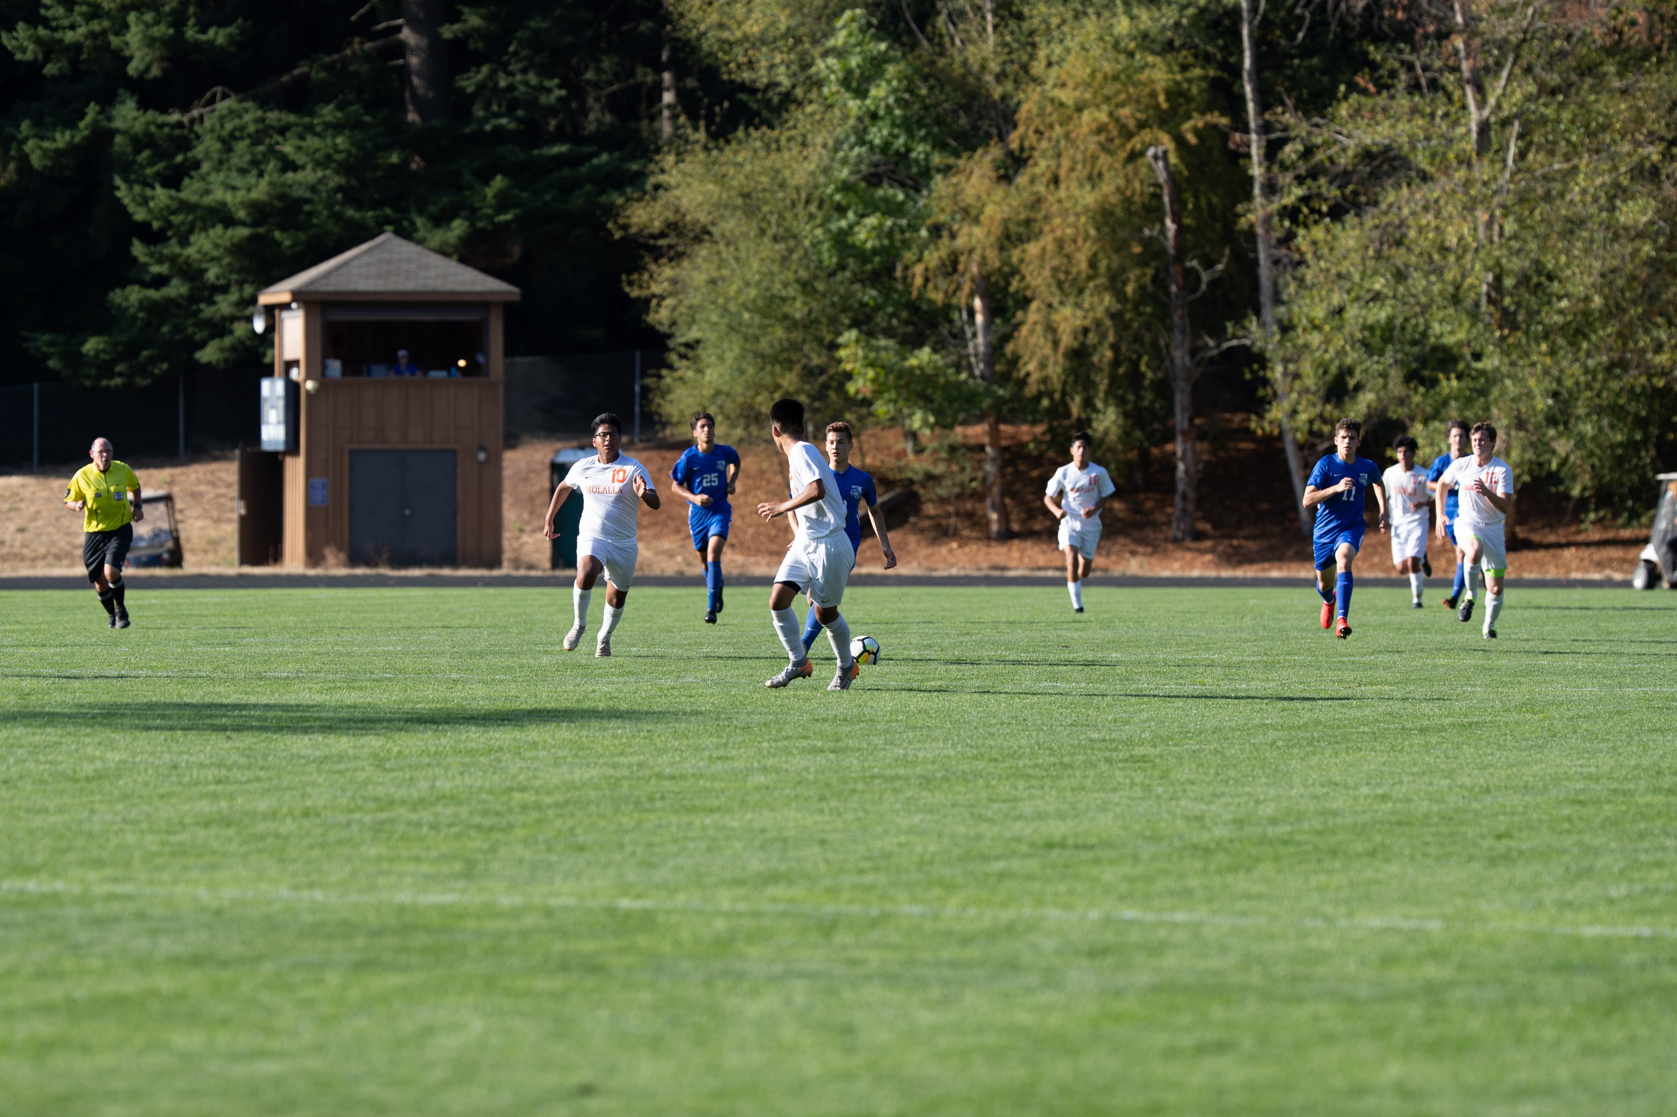
College Soccer Scholarship Requirement
College coaches require soccer players to submit highlight video and game film to be considered for an athletic scholarship.

Slide 3
Issues facing the Student Athlete
Recording and processing video is time-consuming
The athlete must rely on others for game video
People enjoy watching the game, not being a videographer
The required hardware and software are expensive.

Slide 4
Business Problem
D1 men's soccer programs can give out a maximum of 9.9 scholarships a year and these can be a mix of full-ride scholarships and partial scholarships.
Division I and Division II schools provided more than $3 billion in athletic scholarships in 2017
The financial impact of a scholarship is substantial

Slide 5
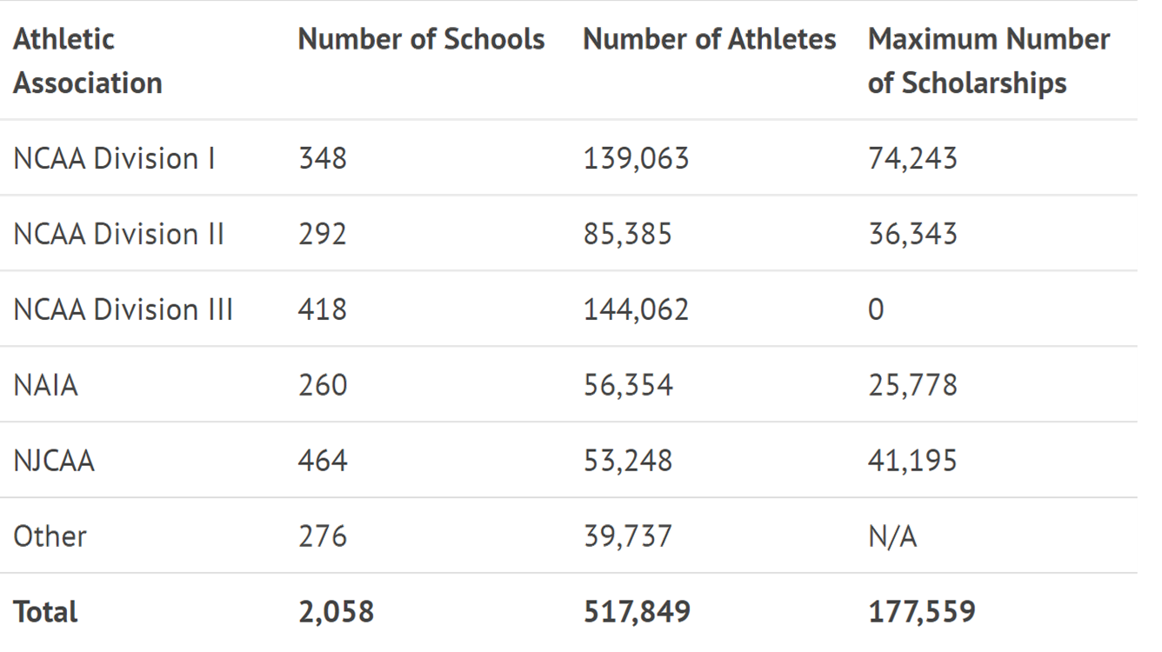
Who gives scholarships?
https://www.ncsasports.org/recruiting/how-to-get-recruited/scholarship-facts

Slide 6
Springboard Project Goal
Identify a target player on the pitch in a photograph

Slide 7
Springboard Capstone Project
Faces extracted from the video (image)
Facial recognition applied to images
Target player identified

Slide 8
Post Springboard Enhancements
Videos of pitch stitched together
Faces extracted from the video (image)
Facial recognition applied to image
Target player identified
Target player tracked
Create college highlight video
Springboard Capstone Project

Slide 9
Overview of the Process
Source photograph from pitch
Locate probable faces
Remove objects (non-faces)
Remove out-of-focus photos
Apply facial recognition model
Identify target player

Slide 10
Overview of the Process
Source photograph from pitch
Locate probable faces
Remove objects (non-faces)
Remove out-of-focus photos
Apply facial recognition model
Identify target player

Slide 11










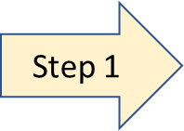
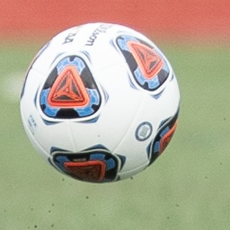
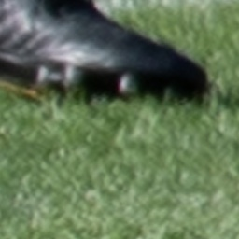
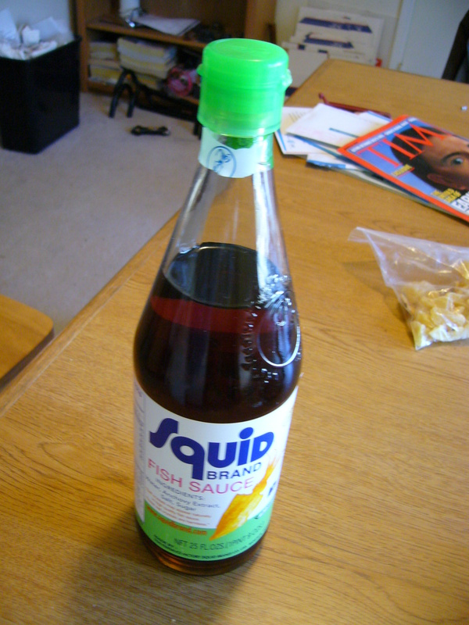

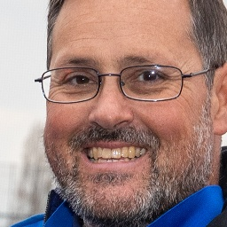

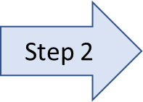


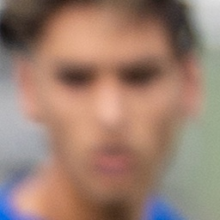

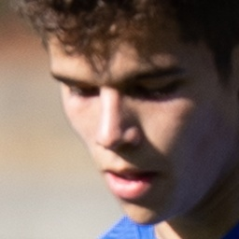


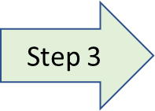

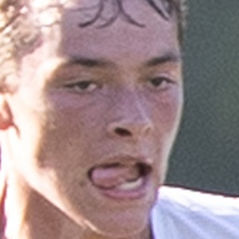
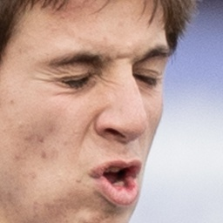
Source Photo
Face Detector (MTCNN)
Face vs Object Model
Source photograph from pitch
Locate probable faces
Remove objects (non-faces)
Remove out-of-focus photos
Apply facial recognition model
Identify target player
Focused vs Unfocused Model
Recognizer Model

Slide 12
Locate Faces
Face Detector (MTCNN)
Face vs Object Model
Source photograph from pitch
Locate probable faces
Remove objects (non-faces)
Remove out-of-focus photos
Apply facial recognition model
Identify target player
Focused vs Unfocused Model
Recognizer Model

Slide 13
Locate Faces
Face Detector (MTCNN)
Source photograph from pitch
Locate probable faces
Remove objects (non-faces)
Remove out-of-focus photos
Apply facial recognition model
Identify target player
Focused vs Unfocused Model
Recognizer Model
Face vs Object Model

Slide 14
Remove Objects (non-faces)
Face Detector (MTCNN)
Source photograph from pitch
Locate probable faces
Remove objects (non-faces)
Remove out-of-focus photos
Apply facial recognition model
Identify target player
Focused vs Unfocused Model
Recognizer Model
Face vs Object Model

Slide 15
Remove Objects (non-faces)
Face Detector (MTCNN)
Source photograph from pitch
Locate probable faces
Remove objects (non-faces)
Remove out-of-focus photos
Apply facial recognition model
Identify target player
Recognizer Model
Face vs Object Model
Focused vs Unfocused Model

Slide 16
Remove Out-of-Focus Faces
Face vs Object Model
Face Detector (MTCNN)
Source photograph from pitch
Locate probable faces
Remove objects (non-faces)
Remove out-of-focus photos
Apply facial recognition model
Identify target player
Recognizer Model
Focused vs Unfocused Model

Slide 17
Remove Out-of-Focus Faces
Face vs Object Model
Face Detector (MTCNN)
Source photograph from pitch
Locate probable faces
Remove objects (non-faces)
Remove out-of-focus photos
Apply facial recognition model
Identify target player
Focused vs Unfocused Model
Recognizer Model

Slide 18
Identify Target Player
Face vs Object Model
Face Detector (MTCNN)
Focused vs Unfocused Model
Source photograph from pitch
Locate probable faces
Remove objects (non-faces)
Remove out-of-focus photos
Apply facial recognition model
Identify target player
Recognizer Model

Slide 19
Identify Target Player
Face vs Object Model
Face Detector (MTCNN)
Focused vs Unfocused Model
Source photograph from pitch
Locate probable faces
Remove objects (non-faces)
Remove out-of-focus photos
Apply facial recognition model
Identify target player
Recognizer Model

Slide 20
Identify Target Player
Face Detector (MTCNN)
Face vs Object Model
Source photograph from pitch
Locate probable faces
Remove objects (non-faces)
Remove out-of-focus photos
Apply facial recognition model
Identify target player
Focused vs Unfocused Model
Recognizer Model

Slide 21
Summary
Face Detector (MTCNN)
Face vs Object Model
Focused vs Unfocused Model
Recognizer Model

Slide 22
Models Trained
Face Detector (MTCNN)
Face vs Object Model
Focused vs Unfocused Model
Recognizer Model

Slide 23
Train “Face vs Object Model”
Face Detector (MTCNN)
Face vs Object Model
Focused vs Unfocused Model
Recognizer Model

Slide 24
Model Trained
Face vs Object Model
Face Detector (MTCNN)
Face vs Object Model
Focused vs Unfocused Model
Recognizer Model

Slide 25
Train “Focused vs Unfocused” Model
Face vs Object Model
Face Detector (MTCNN)
Face vs Object Model
Focused vs Unfocused Model
Recognizer Model

Slide 26
Models Trained
Face Detector (MTCNN)
Face vs Object Model
Focused vs Unfocused Model
Recognizer Model

Slide 27
Train Facial Recognition Model
Face vs Object Model
Face Detector (MTCNN)
Focused vs Unfocused Model
Recognizer Model

Slide 28
Models Trained
Face Detector (MTCNN)
Face vs Object Model
Focused vs Unfocused Model
Recognizer Model

